Slide 1

AIFL PROJECT
SETUP AI TEAMS | DRIVE AI DRIVEN CULTURE
©Great Learning. Proprietary content. All Rights Reserved. Unauthorised use or distribution prohibited

Slide 2

DATA SCIENCE ECOSYSTEM
ORGANISATION TYPE
DATA SCIENCE TEAMS
PRODUCT DETAILS
EXECUTION & OPERATIONS
INDEX
©Great Learning. Proprietary content. All Rights Reserved. Unauthorised use or distribution prohibited
Designed by :
KRISHNAV DAVE

Slide 3
1
2
PRODUCT DETAILS
ORGANISATION TYPE
In the previous project we had proposed Design and deploy a chatbot as the first interface between the user and the support team and user and medical team. Chatbot can talk real time with users, understand if the request is redundant [generic in nature or procedure oriented]. Once the chatbot identifies the redundant request diverts the user to the pre-recorded solution procedure or set up a Realtime conversation with support team and medical team as per the request and appointment. Application can also predict disease when user enters the symptoms and talk and motivate users who might be feeling low.
For further details please refer the previous project.
Organization XYZ is an Medical or HealthCare Company. It has various branches and sub branches spread across different business units and there is a data science team centralizing all units -> connecting them by a single platform.
Being the AI leader have to build a team for
developing this product.
©Great Learning. Proprietary content. All Rights Reserved. Unauthorised use or distribution prohibited
Designed by :
KRISHNAV DAVE

Slide 4
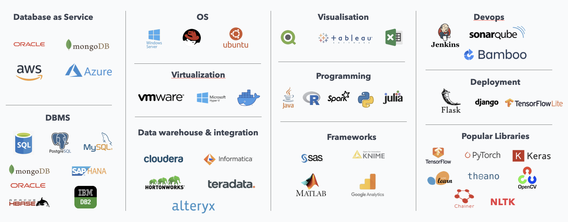
Example
3
DATA SCIENCE ECOSYSTEM
Step 1 - DB: It includes three boxes from above figure i.e. Data as service, DBMS and data warehousing
Step 2 - Development: It includes three boxes from above figure i.e. Programming, Libraries, Frameworks and visualisation
Step 3 - Visualisation: It includes two boxes from above figure i.e. Virtualisation and OS
Step 4 - Deployment: It includes 2 boxes from above figure i.e. Deployment and PLM like devops, Agile, CI-CD etc.
Example of a typical end to end data science ecosystem
©Great Learning. Proprietary content. All Rights Reserved. Unauthorised use or distribution prohibited
Designed by :
KRISHNAV DAVE

Slide 5
Data Planning
Data Base Management
For building the training data for disease predictor and emotion sensitive chatbot I need to have a planned approach towards data where I need to gather a large data which had customer history along with disease diagnosed and multiple client-user interactions with healthcare experts.
For maintaining the training data for disease predictor and emotion sensitive chatbot I need to have a centralised DB servers to store a large data which had multiple client-user interactions with healthcare experts and also store whether the disease predicted was right or not (feedback).
3
Data Warehousing
AI Model development
DATA SCIENCE ECOSYSTEM
Since it an in-house data generation scheme, I would require a very versatile team with a capability to design, develop, test, validate and deploy the product.
May healthcare support team is spread across the globe and need to assemble and organise data across countries into a singular dataset
Describe Organisation’s techno-functional capabilities
AI Product Lifecycle Management
Virtualisation
Since it an in-house data generation scheme, I would require a very versatile team with a capability to design, develop, test, validate and deploy the product.
Large text processing and model learning would
require high performance virtual machines.
©Great Learning. Proprietary content. All Rights Reserved. Unauthorised use or distribution prohibited
Designed by :
KRISHNAV DAVE

Slide 6
Please Note: Add more teams if required
SENIOR MANAGEMENT
CENTRALISED COE
Put your inputs here
SALES TEAM
Put your inputs here
Put your inputs here
4
CHIEF SPONSOR
DATA SCIENCE TEAMS
Put your inputs here
FUNCTIONAL SME
DATA SCIENCE SME
IT/DEPLOYMENT SME
Put your inputs here
Put your inputs here
Put your inputs here
©Great Learning. Proprietary content. All Rights Reserved. Unauthorised use or distribution prohibited
Designed by :
KRISHNAV DAVE

Slide 7
Please Note: Add more teams if required
CENTRALISED COE
INFRA SUPPORT
Put your inputs here
Put your inputs here
4
DATA SCIENCE SME
DATA SCIENCE TEAMS
Put your inputs here
DATA SME
MODEL DESIGN SME
MODEL TEST SME
Put your inputs here
Put your inputs here
Put your inputs here
©Great Learning. Proprietary content. All Rights Reserved. Unauthorised use or distribution prohibited
Designed by :
KRISHNAV DAVE

Slide 8
5
EXECUTION & OPERATIONS
List down all steps specific to roles to enable to product from design to deployment phase
End to end product lifecycle management structure and procedure
©Great Learning. Proprietary content. All Rights Reserved. Unauthorised use or distribution prohibited
Designed by :
KRISHNAV DAVE

Slide 9
AIFL PROJECT
SETUP AI TEAMS | DRIVE AI DRIVEN CULTURE
©Great Learning. Proprietary content. All Rights Reserved. Unauthorised use or distribution prohibited

